Slide 1

Computer System Servicing

Slide 2

RECALL/RECAP

Slide 3
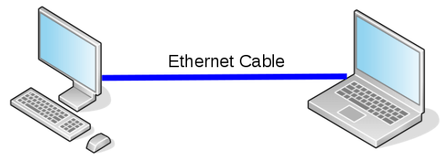
Motivation:

Slide 4
Creating Crossover Cable

Slide 5
Crossover Cable
A type of cable used for the interconnection of two similar devices.

Slide 6

Steps in Creating Crossover Cable
1. Prepare the tools and materials.

Slide 7
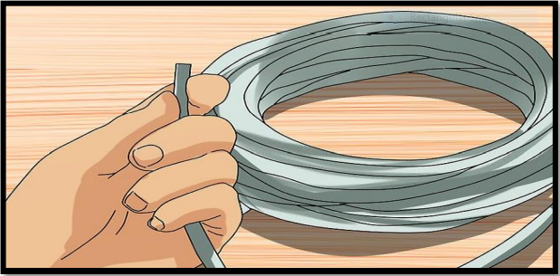
Steps in Creating Crossover Cable
2. Cut the twisted-pair cable based on the needed length.

Slide 8
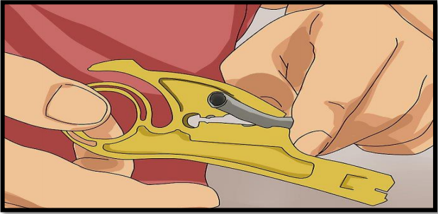
Steps in Creating Crossover Cable
3. Remove the outer jacket of the cable to expose the four pairs of wire inside.

Slide 9
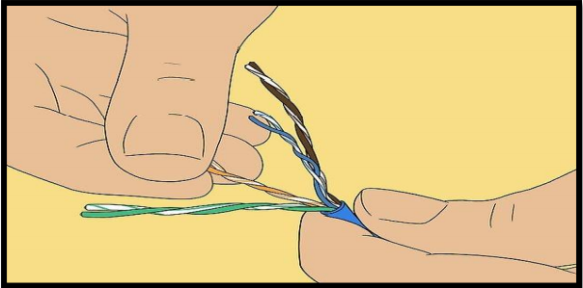
Steps in Creating Crossover Cable
4. Untwist the wires, make sure that they are free from any damage.

Slide 10
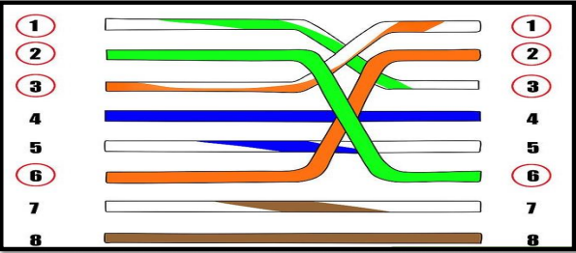
Steps in Creating Crossover Cable
5. Arrange the wire based on the type of cable.

Slide 11
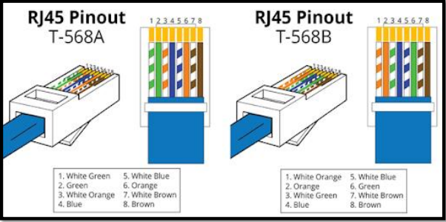
Steps in Creating Crossover Cable
5. Arrange the wire based on the type of cable.

Slide 12
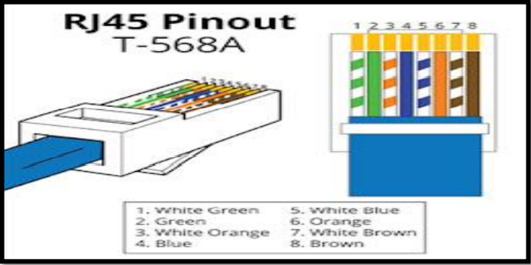
T568-A

Slide 13
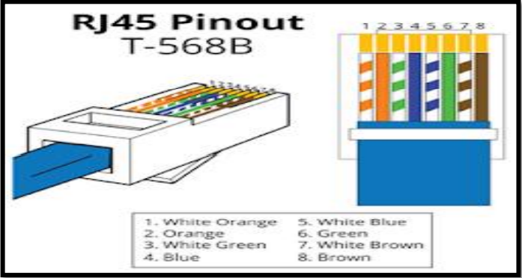
T568-B

Slide 14
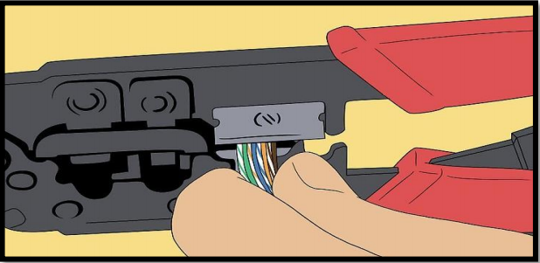
Steps in Creating Crossover Cable
6. Cut the wires so that they will be of exact length, make sure that the ends of the wires are aligned.

Slide 15
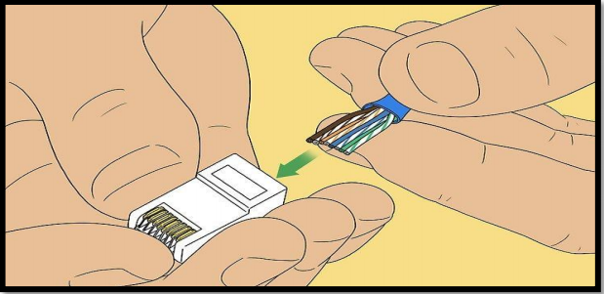
Steps in Creating Crossover Cable
7. Firmly hold the cable and insert the wires into the RJ45 jack.

Slide 16
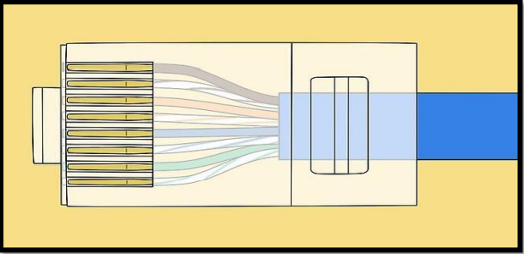
Steps in Creating Crossover Cable
8. Check if the end of the wires touches the end of the RJ45 jack.

Slide 17
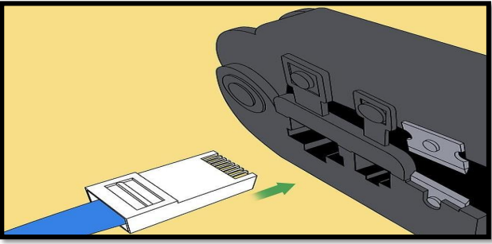
Steps in Creating Crossover Cable
9. Plug the cable into the crimping tool, firmly squeeze it while securely holding the cable.

Slide 18
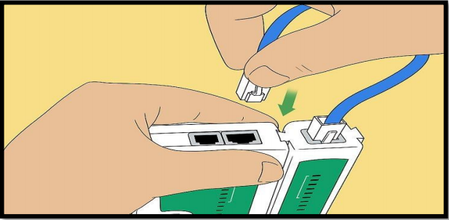
Steps in Creating Crossover Cable
10. Use a LAN Tester to ensure that the connection of all wires in both ends of the cable.

Slide 19
FORMATIVE ASSESSMENT
Direction: Arrange the following sequence of steps in creating straight-through cable.
Write numbers 1-10 on the blank line.

Slide 20
FORMATIVE ASSESSMENT
__ Use a LAN tester to ensure that the connection of all wires in both ends of the cable.
__ Prepare the tools and materials.
__ Plug the cable into the crimping tool, firmly squeeze it while securely holding the cable.
__ Cut the twisted-pair cable based on the needed length.
__ Check if the end of the wires touches the end of the RJ45 jack.
__ Remove the outer jacket of the cable to expose the four pairs of wires inside.
__ Firmly hold the cable and insert the wires into the RJ45 jack.
__ Untwist the wires, make sure that they are free from any damage.
__ Cut the wires so that they will be of exact length, make sure that the ends of the wires are aligned.
__ Arrange the wires based on the type of cable.

Slide 21
Practical Application of the acquired
Learning Competencies

Slide 22

GENERALIZATION

Slide 23
THANK YOU!!!

